Slide 1
RVGS Summer Biomedical Institute

Slide 2
For our talks, scientists will
Talk about their education and career for 10-15 minutes
Talk about their research for 20-25 minutes
Answer questions for 10-15 minutes
At any point during the talk, you can send me a question for the scientist using “Remind” and I will ask the question.
Questions can be general about education and career or
Specific questions about research

Slide 3
Listening to scientific talks
I don’t know any of these words and I am lost!
Some of that went over my head but what I understood was really interesting!

Slide 4
Listening to scientific talks
Pay attention to the main story line
What problem is the scientist working on?
How does it relate to broader issues in medicine and health?
How was the experiment set up? Does the set-up make sense? What control groups were used?
What do the results mean?
What questions are raised by the results?

Slide 5
Listening to scientific talks

Slide 6
Terms you might hear:
Assay: An experiment
“To test that idea, we set up an assay.”

Slide 7
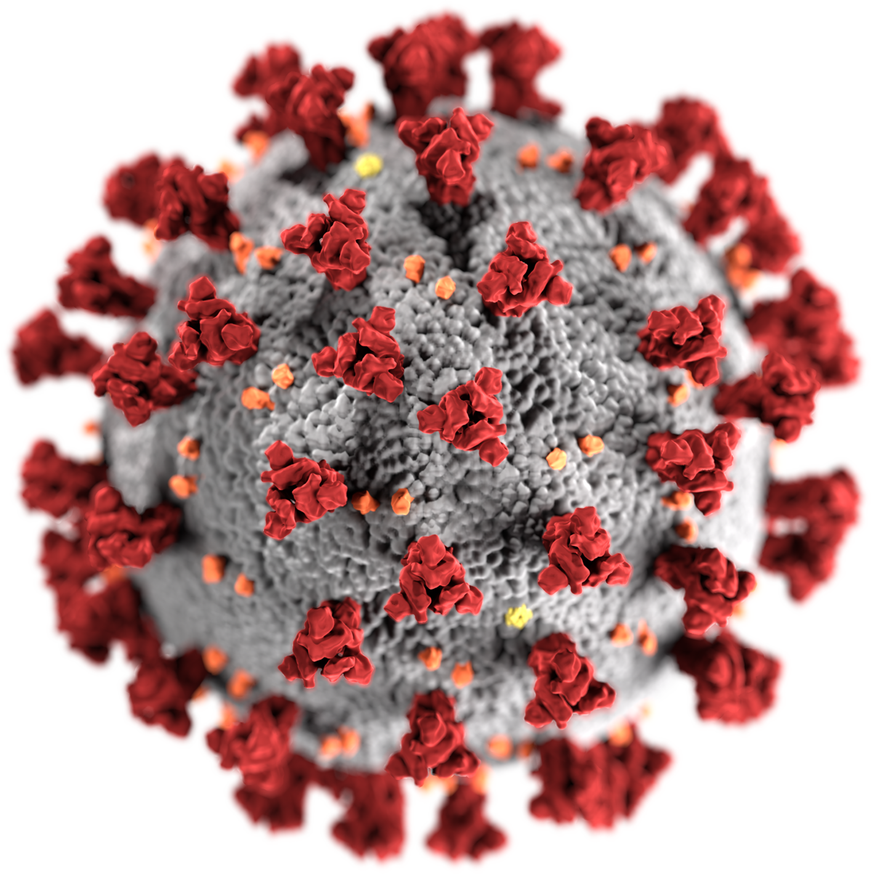
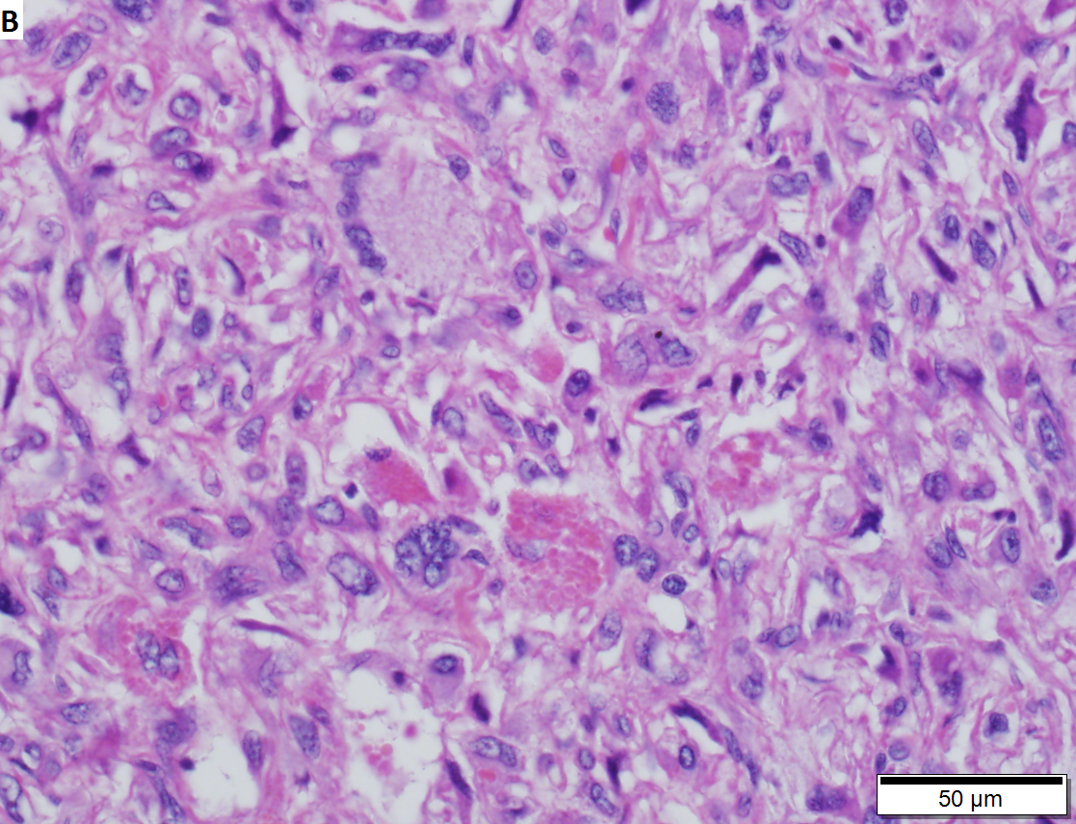
Terms you might hear
Pathogen
A virus, bacteria, fungus, or some other microorganism that causes disease
Pathology
The science of the causes and effects of disease
Often associated with lab examination of samples of body tissue

Slide 8
Basic Molecular Biology

Slide 9
Central Dogma Gene Expression

Slide 10
Single gene studies Gene Therapy Gene Editing

Slide 11
‘Omics

Slide 12
Comparative Genomics Studies
https://genomics.senescence.info/science.html

Slide 13
Personalized Medicine

Slide 14
Major Types of Cells in Humans
Somatic Cells
Germline Cells
Produce gametes
https://ib.bioninja.com.au/standard-level/topic-3-genetics/33-meiosis/somatic-vs-germline-mutatio.html

Slide 15
Stem Cells

Slide 16
Embryonic versus Adult Stem Cells

Slide 17
iPS/ iPSC: Induced Pluripotent Stem Cells
Body cells that have been reprogrammed back into an embryonic state
Now, they can differentiate into any kind of cell

Slide 18
Cells in the brain
https://www.ninds.nih.gov/Disorders/Patient-Caregiver-Education/Life-and-Death-Neuron

Slide 19
Neuron Structure

Slide 20
Support Cells
https://www.ninds.nih.gov/Disorders/Patient-Caregiver-Education/Life-and-Death-Neuron

Slide 21
Astrocytes Lots of functions; help with communication, promote blood flow, help form blood brain barrier Oligodendrocytes myelinate axons which helps speed up signals Microglia immune cells that protect against pathogens

Slide 22
Bioengineering applies engineering principles of design and analysis to biological systems and biomedical technologies https://bioeng.berkeley.edu/about-us/what-is-bioengineering
https://bioe.uw.edu/academic-programs/about-bioengineering/

Slide 23
Any Questions, Comments, Concerns?
If yes, send me a remind message now!

